Slide 1
Object Oriented Analysis & Design

Slide 2
Course Contents
Chapter 1 : Object Oriented Fundamentals
Chapter 2: Object Oriented Analysis
Chapter 3: Object Oriented Design
Chapter 4: Implementation

Slide 3
Today’s Objective
To introduce object oriented fundamentals
  Includes
  Introduction
  What is object oriented analysis &Design

Slide 4
1.1 Introduction

Slide 5
What is an Object?
Objects are key to understanding object-oriented technology.
Look around right now and we’ll find many examples of real-world objects: dog, desk, television set, bicycle.
Objects are the physical and conceptual things we find in the universe around us.
Hardware, software, documents, human beings, and even concepts are all examples of objects.

Slide 6
What is an object?
  An automotive engineer would see tires, doors, engines, top speed, and the current fuel level as objects.
  Atoms, molecules, volumes, and temperatures would all be objects a chemist might consider in creating an object-oriented simulation of a chemical reaction.
  A software engineer would consider stacks, queues, windows, and check boxes as objects.

Slide 7
Class
Two broad categories of objects: classes and instances.
  Users of object-oriented technology usually think of classes as containing the information necessary to create instances, i.e., the structure and capabilities of an instance is determined by its corresponding class.
  There are three commonly used (and different) views on the definition for "class":
  A class is a pattern, template, or blueprint for a category of structurally identical items.
  The items created using the class are called instances.

Slide 8
Class contd..
  2. A class is a thing that consists of both a pattern and a mechanism for creating items based on that pattern
  instances are the individual items that are "manufactured" (created) using the class's creation mechanism.
  3. A class is the set of all items created using a specific pattern. Said another way, the class is the set of all instances of that pattern.

Slide 9
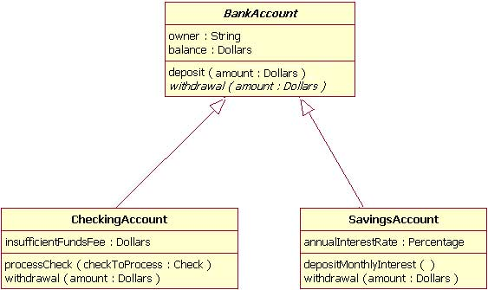
Class Diagram

Slide 10
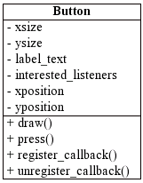

Class
VISIBILITY MODES
+ Public
- Private
# Protected
~ Package
/ Derived
underline Static

Slide 11
Assignment I
Discuss about various visibility types with a suitable example.

Slide 12
Metaclass
We should note that it is possible for an instance of a class to also be a class. A metaclass is a class whose instances themselves are classes.
This means when we use the instance creation mechanism in a metaclass, the instance created will itself be a class.
The instance creation mechanism of this class can, in turn, be used to create instances -- although these instances may or may not themselves be classes.

Slide 13
Real-world objects share two characteristics: They all have
  state and
  behavior

Slide 14
Bicycles also have
  state -current gear, current pedal cadence, current speed and
  behavior -changing gear, changing pedal cadence, applying brakes.
  Identifying the state and behavior for real-world objects is a great way to begin thinking in terms of object-oriented programming.

Slide 15
Difference between class, object & instance
A class is a blueprint which you use to create objects.
An object is an instance of a class - it's a concrete 'thing' that you made using a specific class.
So, 'object' and 'instance' are the same thing, but the word 'instance' indicates the relationship of an object to its class.

Slide 16
Contd…
The basic concept of OOP is this: Class >> Object >> Instance.
A blueprint for a house design is like a class description. All the houses built from that blueprint are objects of that class. A given house is an instance.

Slide 17
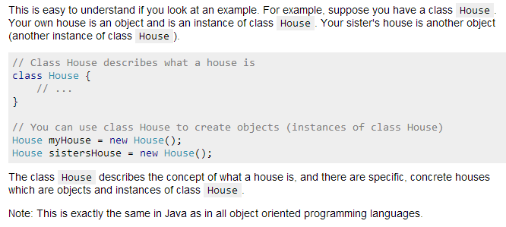
Contd…

Slide 18
Aggregation
It is, of course, possible for objects to be composed of other objects.
Aggregation is either:
  the process of creating a new object from two or more other objects, or
  an object that is composed of two or more other objects.

Slide 19
Contd..
Aggregation is a variant of the "has a" or association relationship ; aggregation is more specific than association.
It is an association that represents a part-whole or part-of relationship.
In UML, it is graphically represented as a hollow diamond shape on the containing class end of the tree with lines that connect contained classes to the containing class.

Slide 20
Composition
Composition is a stronger variant of the "owns a" or association relationship; composition is more specific than aggregation.
Composition usually has a strong life cycle dependency between instances of the container class and instances of the contained class(es).
If the container is destroyed, normally every instance that it contains is destroyed as well.
The UML graphical representation of a composition relationship is a filled diamond shape on the containing class end of the tree of lines that connect contained class(es) to the containing class.

Slide 21
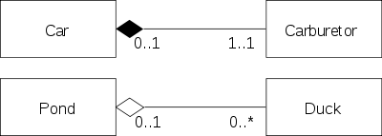
Contd..
Composition
Aggregation

Slide 22
Specialization & Inheritance
Aggregation is not the only way in which two objects can be related. One object can be a specialization of another object. Specialization is either:
the process of defining a new object based on a (typically) more narrow definition of an existing object, or
an object that is directly related to, and more narrowly defined than, another object.

Slide 23
Abstract Classes
Abstract classes are classes that embody coherent and cohesive, but incomplete, concepts, and in turn, make these characteristics available to their specializations via inheritance.
People sometimes use the terms "partial type" and "abstract superclass" as synonyms for abstract class.
While we would never create instances of abstract classes, we most certainly would make their individual characteristics available to more specialized classes via inheritance

Slide 24
1.2 Object Oriented Analysis & Design

Slide 25
What is Object Oriented?
Simplicity through self contained objects
Complexity through integration

Slide 26
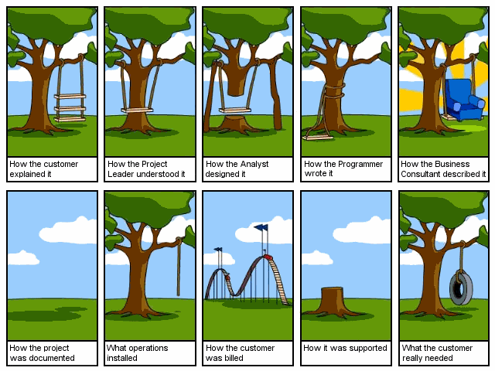
Why Object-Oriented?

Slide 27


Why Object-Oriented? Contd…
“The "software crises" came about when people realized the major problems in software development were … caused by communication difficulties and the management of complexity” [Budd]
The Whorfian Hypothesis:
Human beings … are very much at the mercy of the particular language which has become the medium of expression for their society … the 'real world' is … built upon the language habits … We cut nature up, organize it into concepts, and ascribe significances as we do, largely because we are parties to an agreement to organize it in this way … and is codified in the patterns of our language.


What kind of language can alleviate difficulties with
communication & complexity hopefully well?

Slide 28
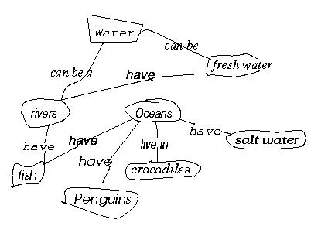
Why Object-Oriented?
- concepts and objects
So, concepts are needed to bring order … into
But, What is CONCEPT? [Martin & Odell] [Novak, 1984, Cambridge University Press]
Study of a first grade class
When given a list of concepts (water, salt water, Oceans, Penguins,...),
Harry constructed a concept diagram through which he understands his world and communicates meaning
Does Harry understand the concepts? Do you understand what Harry understands? Agree or Diagree?

Slide 29
Why Object-Oriented?
… for Conceptual … Modeling Reasons
What kind of language can be used to create this concept diagram, or Harry’s mental image?
Water
Fresh water
have
Rivers
Oceans
have
have
live in
Salt water
have
Crocodiles
Fish
have
Penguins

Slide 30
Why Object-Oriented ->
What is a model and why?
A model is a simplification of reality.
E.g., a miniature bridge for a real bridge to be built
  Well...sort of….but not quite
  A model is our simplification of our perception of reality
  (that is, if it exists, otherwise it could be a mere illusion).
  communication is not about reality but about your/my/his/her perception of reality => validation and verification hard but needed
A model is an abstraction of something for the purpose of understanding, be it the problem or a solution.
To understand why a software system is needed, what it should do, and how it should do it.
To communicate our understanding of why, what and how.
To detect commonalities and differences in your perception, my perception, his perception and her perception of reality.
To detect misunderstandings and miscommunications.

Slide 31



What is Object-Orientation?
- What is Object?
An "object" is anything to which a concept applies, in our awareness
Things drawn from the problem domain or solution space.
  E.g., a living person in the problem domain, a software component in the solution space.
A structure that has identity and properties and behavior
It is an instance of a collective concept, i.e., a class.

Slide 32

What is Object-Orientation
- Abstraction and Encapsulation
Abstraction
  Focus on the essential
  Omits tremendous amount of details
  …Focus on what an object “is and does”
Encapsulation
  a.k.a. information hiding
Objects encapsulate:
  property
  behavior as a collection of methods invoked by messages
  …state as a collection of instance variables

Slide 33
What is Object-Orientation
- Polymorphism
  Objects of different classes respond to the same message differently.
Person
name
SSN
Student
Employee
payTuition
emp-id
std-id
level
payTuition
In-State
Student
Out-of-State
Student
state
payTuition
payTuition

Slide 34
What is Object-Orientation
- Interfaces
Information hiding - all data should be hidden within a class, at least in principle.
make all data attributes private
provide public methods to get and set the data values (cf. Java design patterns)
e.g. Grade information is usually confidential, hence it should be kept
private to the student. Access to the grade information should be
done through interfaces, such as setGrade and getGrade
Student
setGrade
std-id
level
grade
payTuition
setGrade()
getGrade()
getGrade

Slide 35
What is Object-Orientation
- Abstract Class vs. Concrete Class
Abstract Class.
  An incomplete superclass that defines common parts.
  Not instantiated.
Concrete class.
  Is a complete class.
  Describes a concept completely.
  Is intended to be instantiated.

Slide 36
What is Object-Orientation?
-State
What is STATE?
"State" is a collection of association an object has with other objects and object types.
What is STATE CHANGE?
A "state change" is the transition of an object from one state to another.
What is EVENT?
An "event" is a noteworthy change in state [Rumbaugh]

Slide 37
What is Object-Orientation?
-State transition impossible?
tom: Actor
tom: Actor
name = “Tom Cruise”
name = “Tom Holmes”
married/changeLastName
katie: Actor
katie: Actor
name = “Katie Holmes”
name = “Katie Holmes”
tom: Actor
name = “Tom Holmes”
newArrival/getName
katie: Actor
name = “Katie Holmes”
suri: BabyActor
name = “Suri Holmes”

Slide 38
What is Object-Oriented Application?
Collection of discrete objects, interacting w. each other
Objects have property and behavior (causing state transition)
Interactions through message passing
(A sender object sends a request (message) to another object (receiver)
to invoke a method of the receiver object’s)
O1
O2
Data
m1
Data
Fn
Fn
m3
m2
O3
{m in Fn}
Data
Fn

Slide 39
What is OOAD?
Analysis — understanding, finding and describing concepts in the problem domain.
Design — understanding and defining software solution/objects that represent the analysis concepts and will eventually be implemented in code.
OOAD — Analysis is object-oriented and design is object-oriented. A software development approach that emphasizes a logical solution based on objects.
Traceability!
Involves both a notation and a process

Slide 40
Harry again …
What do we see here?
Water
Fresh water
have
Rivers
Oceans
have
have
live in
Salt water
have
Crocodiles
Fish
have
Penguins
Things, Relationships, Diagram

Slide 41
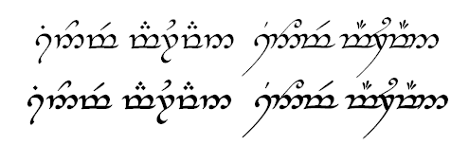
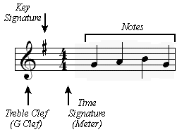
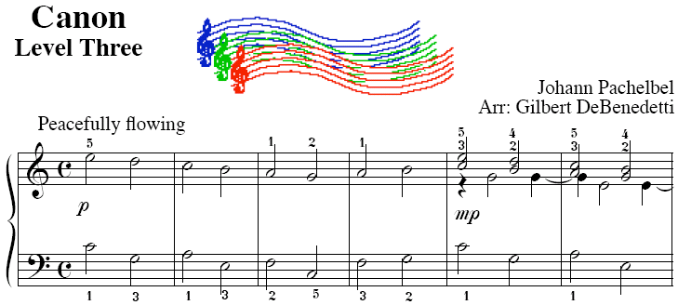

How to do OOAD
- notation vs. process
UML is a notation.
So are English, Elvish, Ku, …
But as yet I can’t

Slide 42
What is Analysis & Design?
Analysis emphasizes on investigation of the problem & requirements, rather than a solution
For e.g. if a new trading system is required
  Analysis deals with
    what are its functions?
    how will it be used?
Analysis is a broad term, best qualified as in requirement analysis( investigation of requirements) or object oriented analysis .

Slide 43
What is Analysis & Design? contd..
Design emphasizes a conceptual solution( in software & hardware) that fulfills the requirement, rather than its implementation.
For e.g. description of database schema
Design ideas often exclude low level details
Ultimately designs are implemented , & the implementation expresses the true & complete realized design

Slide 44
What is object oriented analysis & design?
Object Oriented Analysis emphasizes on finding & describing the objects- or concepts in the problem domain.
For e.g. flight automation system
  Concepts include Plane, Flight, Pilot etc.
During the object oriented design, there is an emphasis on defining software objects & how they collaborate to fulfill the requirements.

Slide 45
What is object oriented analysis & design? Contd…
For example Flight Automation System has one object –Plane
May have
  Attribute – tailNumber
  Method - getFlightHistory
finally during implementation i.e. OOP, design objects are implemented, such as Plane class in Java

Slide 46
Contd…
public class Plane
{
private String tailNumber;
Public List getFlightHistory(){….}
}

Slide 47
Object Oriented Analysis

Slide 48
Understanding Analysis
In software engineering, analysis is the process of converting the user requirements to system specification
  system means the software to be developed.
System specification, also known as the logic structure, is the developer’s view of the system.
Function-oriented analysis – concentrating on the decomposition of complex functions to simply ones.
Object-oriented analysis – identifying objects and the relationship between objects.

Slide 49
Understanding Analysis
The goal in Analysis is to understand the problem
  and to begin to develop a visual model of what you are trying to build, independent of implementation and technology concerns.
Analysis focuses on translating the functional requirements into software concepts.
  The idea is to get a rough cut at the objects that comprise our system, but focusing on behavior (and therefore encapsulation).
  We then move very quickly, nearly seamlessly into “design” and the other concerns.

Slide 50
Analysis Versus Design
Analysis
  Focus on understanding the problem
  Idealized design
  Behavior
  System structure
  Functional requirements
  A small model
Design
  Focus on understanding the solution
  Operations and Attributes
  Performance
  Close to real code
  Object lifecycles
  Non-functional requirements
  A large model
Notes:
An instructor once said: “Analysis Vs. Design is important because of the mind-set. If you tried to manage all of the analysis and design issues in one go, your brain would explode on all but the most trivial developments. It’s just too much to take in, comprehend, and model in one go. So I mentally switch “OK, analysis - problem domain - don’t care about memory, persistence, databases, language, etc”. “Right now it’s design and I do care about all those things - but now I can stop thinking (too a degree) about trying to understand the business domain.” It’s about managing the 7+/-2 things I can think about in one go. It also separates out the skills (a bit).”
Another instructor once said: “analysis is the study of and eventual comprehension of “some thing” [the problem space]. But to understand it, we must invent some entities to hold onto the thing that we have just grasped - this inventive process is design. That is, human cognitive thinking is actually interwoven analysis/design and any attempt to separate them is really only an idealization. Therefore, if I try to apply two separate “steps” in the production of, say, a class diagram [and call those steps A and then D], I will introduce ambiguity into my process because cognitive process forces one to “produce a solution” in order to “understand a problem” - that D is necessary to have any results from A.”
Think of analysis as an idealized design step - where we ignore several complicating issues. This can turn into a religious debate.

Slide 51
Object Oriented Analysis(OOA)
Object-oriented analysis (OOA) applies object-modeling techniques to analyze the functional requirements for a system.
Emphasizes an investigation of the problem
A typical OOA model would describe computer software that could be used to satisfy a set of customer-defined requirements.

Slide 52
OOA..
During the analysis phase of problem-solving, a programmer might consider a written requirements statement, a formal vision document, or interviews with stakeholders or other interested parties.
The task to be addressed might be divided into several subtasks (or domains), each representing a different business, technological, or other areas of interest.

Slide 53
OOA..
The conceptual model that results from OOA will typically consist of a set of use cases, one or more UML class diagrams, and a number of interaction diagrams.
It may also include some kind of user interface mock-up.
OOA focuses on what the system does.
“Do The Right Thing “ - Analysis

Slide 54
Object Oriented Analysis
Identifying objects:
  Using concepts, CRC cards, stereotypes, etc.
Organising the objects:
  classifying the objects identified, so similar objects can later be defined in the same class.
Identifying relationships between objects:
  this helps to determine inputs and outputs of an object.
Defining operations of the objects:
  the way of processing data within an object.
Defining objects internally:
  information held within the objects.

Slide 55
Object Oriented Design (OOD)
Object-oriented design (OOD) elaborates the analysis models to produce implementation specifications.
Emphasizes a conceptual solution
During object-oriented design (OOD), a developer applies implementation constraints to the conceptual model produced in object-oriented analysis.

Slide 56
OOD..
Such constraints could include not only
  constraints imposed by the chosen architecture
  but also any non-functional – technological or environmental – constraints, such as transaction throughput, response time, run-time platform, development environment, or those inherent in the programming language.

Slide 57
OOD..
Concepts in the analysis model are mapped onto implementation classes and interfaces resulting in a model of the solution domain, i.e., a detailed description of how the system is to be built.
OOD on how the system does it.
“Do The Thing Right” - Design

Slide 58
OOAD Objective
To identify relevant objects in the subject domain
To drill down the relevant sub objects
To discover patterns & relationships so that efficient object grouping can be made providing effective system architecture.

Slide 59
OOAD benefits
Re-use
  Shared components
Stability
  Interchangeable parts
Reliability
  Reduced complexity of individual components
Integrity
  Protected data & code
Iterative modeling
  Vs. interpretation & recreation

Slide 60
Example – A Dice Game
Here, software simulates a player rolling two dice.
If the total is seven they win else they loose.
Define use cases
  Requirement analysis may include stories & scenarios of how people use the application; these can be written as use cases.

Slide 61
Use Case
In software and systems engineering, a use case is a list of steps, typically defining interactions between a role (known in UML as an "actor") and a system, to achieve a goal.
The actor can be a human or an external system.
Ivar Jacobson first formulated textual, structural and visual modeling techniques for specifying use cases in 1986

Slide 62
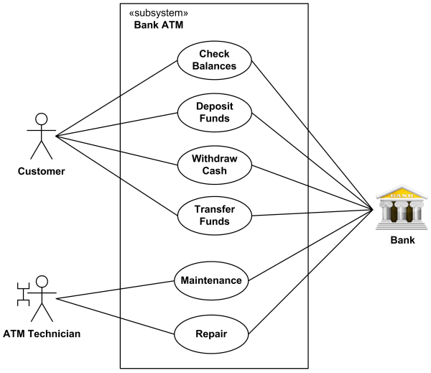
Example 1 Use Case

Slide 63
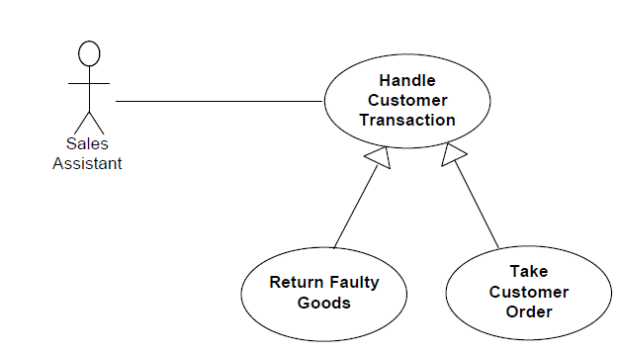
Example 2 Use Case-Extends

Slide 64
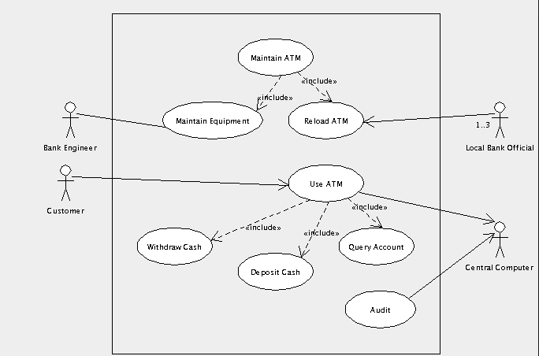
Example 3 –Use Case- Include

Slide 65
Example – A Dice Game contd…
  Here, player requests to roll a dice.
  System presents the results.
  If the dice face value totals seven, player wins else the player loses.
Define Domain Model
  Object Oriented Analysis is concerned with creating description of domain from perspective of objects.
  There is an identification of concepts, attributes & associations that are considered.
  The result can be expressed in domain model.

Slide 66
Example – A Dice Game contd…
  This model illustrates Player, Die & Dice game, with their attributes and associations
  It does not show the operations
  In other words, domain model is not a description of software objects;
  It is a visualization of the concepts of the real world domain
  Also called a conceptual object model.

Slide 67
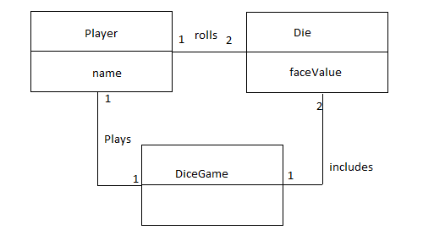
Fig: Partial Domain model of the Dice Game

Slide 68
Example – A Dice Game contd…
Assign Object responsibilities & draw interaction diagrams
  OO design is concerned with defining software objects- their responsibilities and collaborations
  Common notation - Sequence Diagram
    Shows the flow of messages between software objects

Slide 69
Example – A Dice Game contd…
Fig illustrates an OO software design, by sending messages to instance of DiceGame & Die classes.

Slide 70
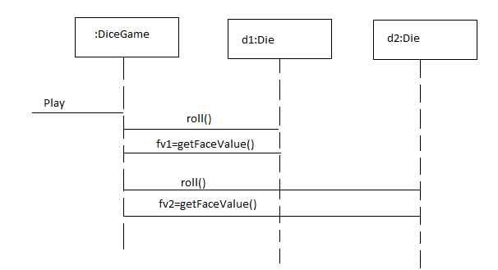
Fig: Sequence Diagram illustrating messages between software objects

Slide 71
Example – A Dice Game contd…
Define Design Class Diagrams
  In addition to a dynamic view of collaborating objects shown in interaction diagrams, a static flow of the class definitions are best shown with class diagrams
  This illustrates the attributes and methods of the classes.
  For example, in a dice game, an inspection of the sequence diagram leads to the partial class diagram shown in fig below.

Slide 72
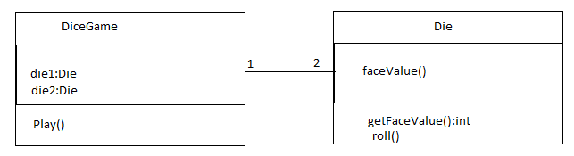
Fig: Partial design Class Diagram

Slide 73
Since play message is sent to DiceGame object, the DiceGame class requires a play method, while class Die requires a roll & getFaceValue method.

Slide 74
Domain Model
A domain model in problem solving and software engineering can be thought of as a conceptual model of a domain of interest (often referred to as a problem domain)
It describes the various entities, their attributes, roles and relationships, plus the constraints that govern the integrity of the model elements comprising that problem domain.
Notes:
Object Oriented Fundamentals

Slide 75
Contd..
The domain model is created in order to represent the vocabulary and key concepts of the problem domain.
The domain model also identifies the relationships among all the entities within the scope of the problem domain, and commonly identifies their attributes.

Slide 76
Contd..
The domain model can be effectively used to verify and validate the understanding of the problem domain among various stakeholders.
It is especially helpful as a communication tool and a focusing point both amongst the different members of the business team as well as between the technical and business teams.

Slide 77
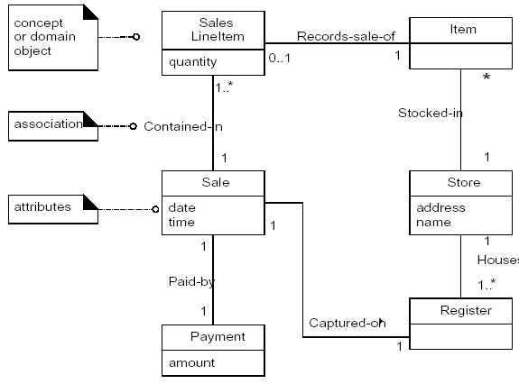
Domain Models
Using UML notation, a domain model is illustrated with a set of class diagrams in which no operations are defined. It may show:
  domain objects or conceptual classes
  associations between conceptual classes
  attributes of conceptual classes

Slide 78
Domain Modeling Guidelines
How to Make a Domain Model
  1. List the candidate conceptual classes using the Conceptual Class Category List and noun phrase identification techniques related to the current requirements under consideration.
  2. Draw them in a domain model.
  3. Add the associations necessary to record relationships for which there is a need to preserve some memory.
  4. Add the attributes necessary to fulfill the information requirements.
On Naming and Modeling Things
  use the vocabulary of the domain when naming conceptual classes and attributes.
    For example, if developing a model for a library, name the customer a "Borrower" or "Patron"—the terms used by the library staff.
  a domain model may exclude conceptual classes in the problem domain not pertinent to the requirements.
    For example, we may exclude Pen and PaperBag from our domain model (for the current set of requirements) since they do not have any obvious noteworthy role.
  the domain model should exclude things not in the problem domain under consideration.

Slide 79
Domain Modeling Guidelines
A Common Mistake in Identifying Conceptual Classes
  Perhaps the most common mistake when creating a domain model is to represent something as an attribute when it should have been a concept.
  A rule of thumb to help prevent this mistake is:
    If we do not think of some conceptual class X as a number or text in the real world, X is probably a conceptual class, not an attribute.
As an example, should store be an attribute of Sale, or a separate conceptual class Store?
  In the real world, a store is not considered a number or text - the term suggests a legal entity, an organization, and something occupies space. Therefore, Store should be a concept.
As another example, consider the domain of airline reservations. Should destination be an attribute of Flight, or a separate conceptual class Airport?
  In the real world, a destination airport is not considered a number or text—it is a massive thing that occupies space. Therefore, Airport should be a concept.

Slide 80
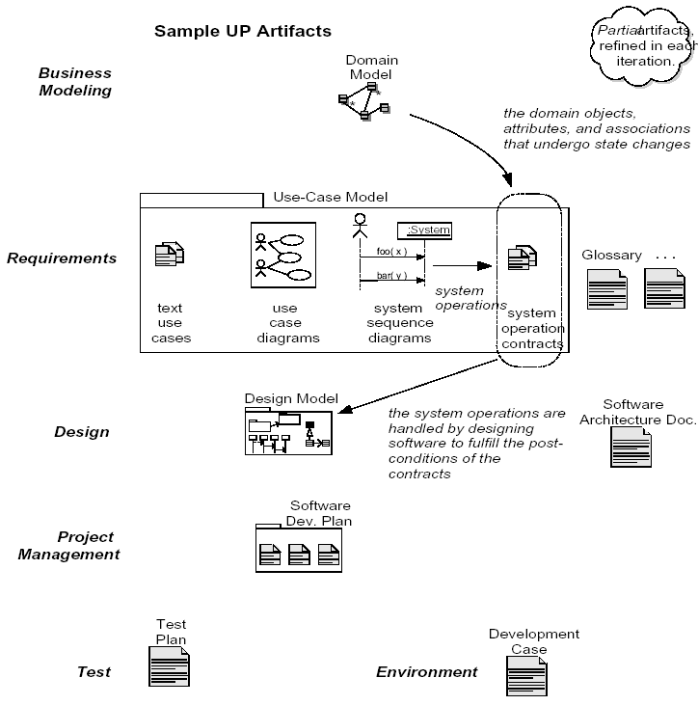
Domain Models within the UP
Artifact influence emphasizing the Domain Model

Slide 81
Assignment -II
Build a Domain model for a scenario of customer placing an order. A customer requires last name, first name & DOB to place an order and the order has order number. One constraint is that one customer can order place one order at a time.

